Slide 1




Slide 2

Creating a Java Thread
Synchronized Keyword
Wait and Notify

Slide 3

Java threads are a way to have different parts of your program running at the same time.
For example, you can create an application that accepts input from different users at the same time, each user handled by a thread.
Also, most networking applications involve threads
– you would need to create a thread that would wait for incoming messages while the rest of your program handles your outgoing messages.

Slide 4
There are two ways to create a java thread
Extending the Thread class
Implementing the runnable interface

Slide 5

We will create a thread that simply prints out a number 500 times in a row.
class MyThread extends Thread { int i;
MyThread(int i) {
this.i = i;
}
public void run() {
for (int ctr=0; ctr < 500; ctr++) {
System.out.print(i);
}
}
}

Slide 6
To show the difference between parallel and non-parallel execution, we have the following executable MyThreadDemo class
class MyThreadDemo {
public static void main(String args[]) { MyThread t1 = new MyThread(1); MyThread t2 = new MyThread(2); MyThread t3 = new MyThread(3); t1.run();
t2.run();
t3.run();
System.out.print("Main ends");
}}

Slide 7
Upon executing MyThreadDemo, we get output that looks like this
$ java MyThreadDemo 1111111111...22222222.....33333......Main ends
As can be seen, our program first executed t1's run method,
which prints 500 consecutive 1's.
After that t2's run method, which prints consecutuve 2's, and
so on.
Main ends appears at the last part of the output as it is the last part of the program.

Slide 8
What happened was serial execution, no multithreaded execution occurred
– This is because we simply called MyThread's run() method

Slide 9
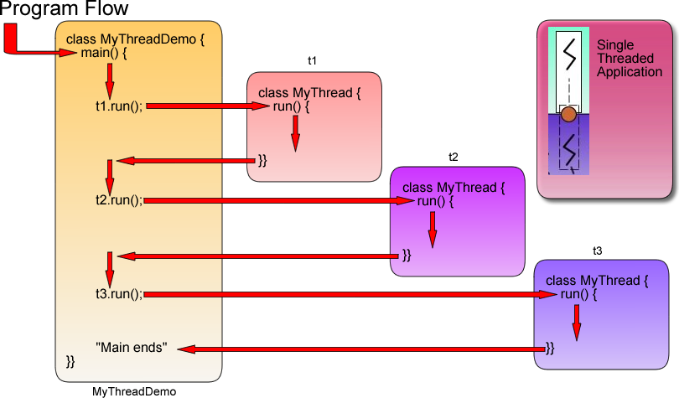

Slide 10
To start parallel execution, we call MyThread's start() method, which is built-in in all thread objects.
class MyThreadDemo {
public static void main(String args[]) { MyThread t1 = new MyThread(1); MyThread t2 = new MyThread(2); MyThread t3 = new MyThread(3); t1.start();
t2.start();
t3.start();
System.out.print("Main ends");
}}

Slide 11
When we run MyThreadDemo we can definitely see that three run methods are executing at the same time
> java MyThreadDemo 111111111122331122321122333331111Main ends111333222...

Slide 12
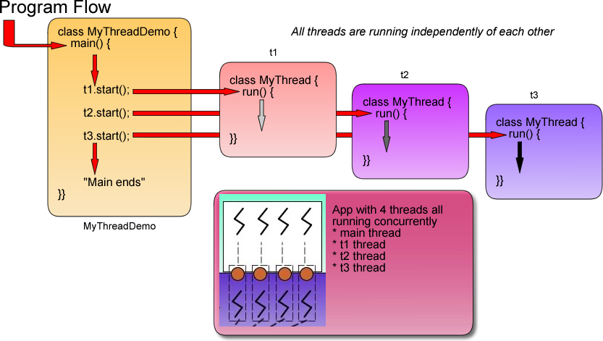

Slide 13
Note the appearance of the "Main ends" string in the middle of the output sequence
> java MyThreadDemo 111111111122331122321122333331111Main ends111333222...
This indicates that the main method has already finished executing while thread 1, thread 2 and thread 3 are still running.

Slide 14
Running a main method creates a thread.
– Normally, your program ends when the main thread ends.
However, creating and then running a thread's start method creates a whole new thread that executes its run() method independent of the main method.

Slide 15

Another way to create a thread is to implement the Runnable interface.
This may be desired if you want your thread to extend another
class.
By extending another class, you will be unable to extend class thread
as Java classes can only extend a single class.
However, a class can implement more than one interface.

Slide 16
The following is our MyThread class created by implementing the runnable interface.
class MyThread implements Runnable {
... <thread body is mostly the same>
}
Classes that implement Runnable are instantiated in a
different way.
– Thread t1 = new Thread(new MyThread(1));

Slide 17

Note that implementing an interface requires you to define all the methods in the interface
For the Runnable interface, you are required in your implementing class to define the run() method or your program will not run.

